Slide 1
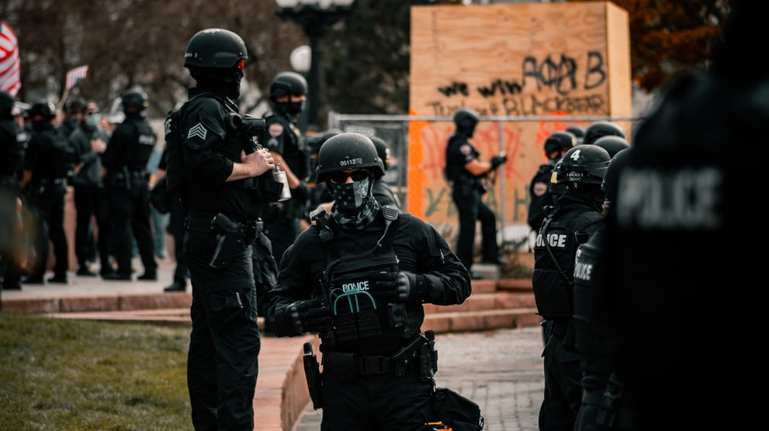
SOCIAL STRUCTURES, INSTITUTIONS & PROBLEMS
GNED 500
WEEK5
Photo by Colin Lloyd from UnSplash

Slide 2
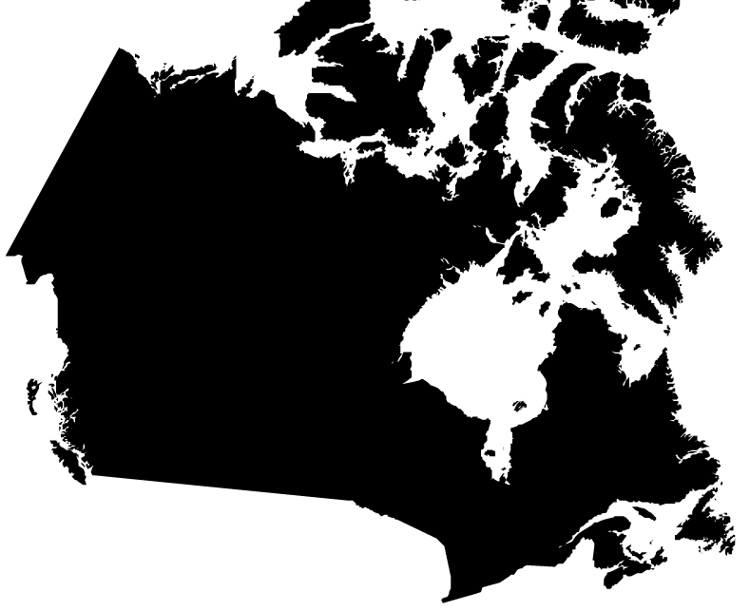
Acknowledgement
Traditional Lands
Canada Map Vectors by Vecteezy
Notes:
Acknowledgement of Traditional Lands
Centennial is proud to be a part of a rich history of education in this province and in this city.
We acknowledge that we are on the treaty lands and territory of the Mississauga’s of the Credit First Nation and pay tribute to their legacy and the legacy of all First Peoples of Canada, as we strengthen ties with the communities we serve and build the future through learning and through our graduates.
Today the traditional meeting place of Toronto is still home to many Indigenous People from across Turtle Island and we are grateful to have the opportunity to work in the communities that have grown in the treaty lands of the Mississauga’s.
We acknowledge that we are all treaty people and accept our responsibility to honor all our relations

Slide 3

AGENDA
UPDATE
REVIEW LAST CLASS
LEARNING OUTCOMES
SOCIAL STRUCTURES
SOCIAL STATUS
SOCIAL ROLES
SOCIAL GROUPS
SOCIAL INSTITUTIONS
SOCIAL STRUCTURES & SOCIAL PROBLEMS
SHAPING SOCIAL INSTITUTIONS
SOCIAL INSTITUIONS CASE STUDY
UNDERSTANDING SOCIAL PROBLEMS
INDIVIDUAL VS SOCIAL PROBLEM
INDIVIDUAL PROBLEMS
SOCIAL PROBLEMS
WHAT MAKES A SOCIAL PROBLEM
A PROBLEM FOR WHOM?
SOCIAL ISSUE CLAIM MAKERS
SOCIAL PROBLEMS IN CONTEXT
Check 3d by d3images - freepik.com
Notes:
UPDATE
REVIEW LAST CLASS
BELIEF
CONFIRAMTION BIAS
IDEOLOGY
ASSUMPTIONS
SOCIAL CONSTRUCT OF IDEOLOGY
DOMINANT IDEOLOGY
DOMINANT DISCOURSE
HEGEMONIC DISCOURSE
COUNTER IDEOLOGIES
MOVEMENTS

Slide 4

LEARNING OUTCOMES
At the end of this session, you will be able to:
Explain the concept of ideology and how various forms of Ideology differ
Determine how dominant ideologies socially construct our understanding of social problems.
Examine how counter ideologies challenge the assumptions embedded in dominant ideologies
Determine which ideologies shape your attitudes, values and behaviours in relation to social problems
Distinguish between individual problems and social problems
Define social problems through exploring characteristics of social problems
Explore methodology for transforming topics of study to researchable social problems
Understand social problems in context
Image created by macrovector - freepik.com
Notes:
The student will reliably demonstrate the ability to:
Reflect critically about one's role as a global citizen in personal and professional life.
Analyze the ways we come to understand the world, our perceptions of ourselves and others.
Critically analyze social issues considering different perspectives and historical roots.
Develop recommendations for a social action plan.

Slide 5
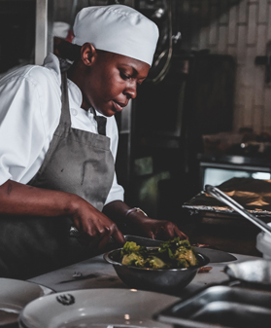
ROLES & PROCEEDURES
We have all been in a situation where we quickly have to learn what to do and how to act.
We learn to follow an established pattern of rules and procedures.
Over time we become so used to these rules and procedures that we follow them while barely even noticing.
Sometimes we even break the rules when we know we can get away with it.
These rules and procedures (the structure) shape our behaviour.
Different settings and organizations (institutions) have their own rules and procedures.
When we look at how they all work and interact with each other, we can start to see how different societies have distinct social structures.
Photo by Jeff Siepman on Unsplash
Notes:
We have all been in a situation where we quickly have to learn what to do and how to act.
We learn to follow an established pattern of rules and procedures.
Over time we become so used to these rules and procedures that we follow them while barely even noticing.
Sometimes we even break the rules when we know we can get away with it.
These rules and procedures (the structure) shape our behaviour.
Different settings and organizations (institutions) have their own rules and procedures.
When we look at how they all work and interact with each other, we can start to see how different societies have distinct social structures.

Slide 6

Social Structure
Social structure refers to the way society is organized.
The basic elements of a social structure are: statuses, roles, groups and institutions.
In subsequent slides, we will discuss statuses, roles and groups.
However our main focus will be on the importance of social institutions and the way the are linked to social problems.
Image by vectorjuice - freepik.com
Notes:
Social structure refers to the way society is organized.
The basic elements of a social structure are: statuses, roles, groups and institutions.
In subsequent chapters, we will discuss statuses, roles and groups.
But here we will focus on the importance of social institutions and the way the are linked to social problems.

Slide 7
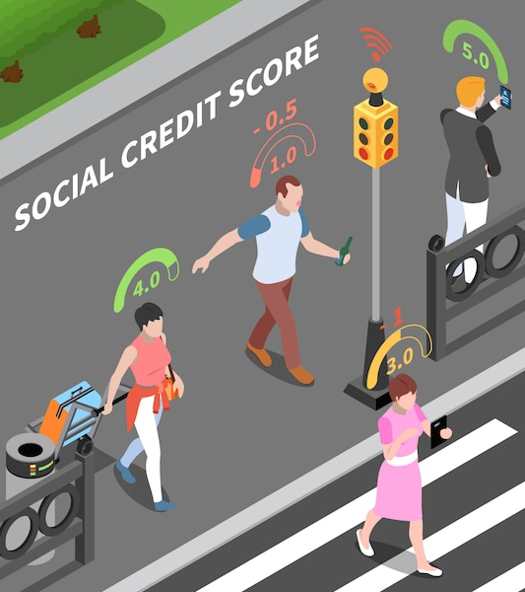
Social STATUS
Position in a group or society that is associated with certain expectations, rights and duties.
Often when we talk about status, we are referring to occupations – e.g., doctor, bus driver, child-care worker, police officer.
But a social status can be any socially defined position: husband, daughter, senior citizen, patient, addict.
All of these are “positions” to which we assign certain behavioural expectations.
Image by macrovector - freepik.com
Notes:
Position in a group or society that is associated with certain expectations, rights and duties.
Often when we talk about status, we are referring to occupations – e.g., doctor, bus driver, child-care worker, police officer.
But a social status can be any socially defined position: husband, daughter, senior citizen, patient, addict.
All of these are “positions” to which we assign certain behavioural expectations.

Slide 8
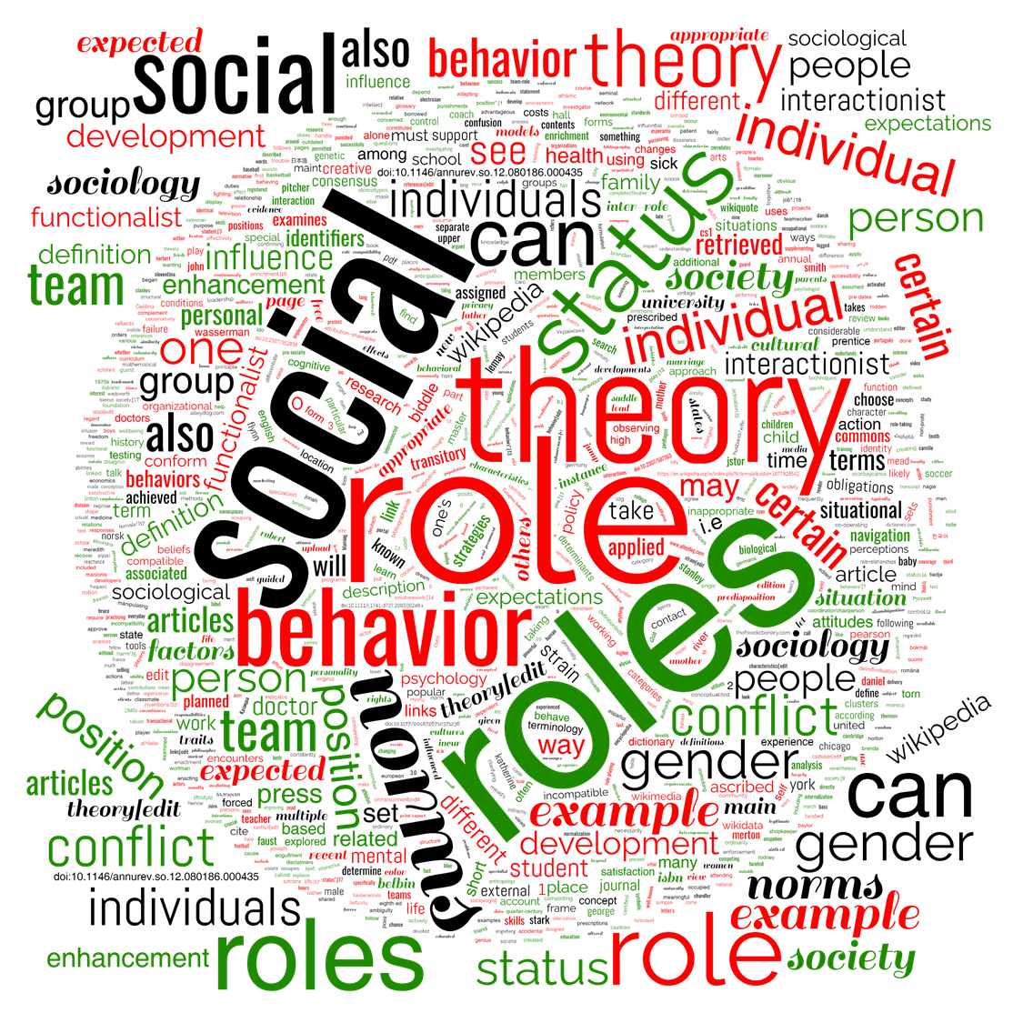
Social ROLES
Behavioural expectations = social roles
Social roles are socially defined patterns of behavior that is expected of persons who occupy a certain social position
Artwork by Hi Profile is licensed under a CC BY-NC-SA 4.0 International License.
Notes:
Behavioural expectations that correspond to a specific status are called social roles.
Social roles are a socially defined pattern of behavior that is expected of persons who occupy a certain social position or belong to a particular social category.

Slide 9

Social GROUPS
Social groups are composed of people who interact frequently and share a common identity and feelings of interdependence; for example, your classmates, your friends, or your family members.
Photo by Jopwell from Pexels.com
Notes:
Position in a group or society that is associated with certain expectations, rights and duties.
Often when we talk about status, we are referring to occupations – e.g., doctor, bus driver, child-care worker, police officer.
But a social status can be any socially defined position: husband, daughter, senior citizen, patient, addict.
All of these are “positions” to which we assign certain behavioural expectations.

Slide 10

Social Institutions
The most recognized social institutions are:
The Family
Religion
Government
Economy
Education
Culture
Media
Image by Hiprofile.com is licensed under a CC BY-NC-SA 4.0 International License.
Notes:
The most recognized social institutions are:
The Family
Religion
Government
Economy
Education
Culture
Media
These social institutions guide and shape our attitudes, values, and even our behaviour.
For example, religion teaches us a set of values and beliefs.
The media (i.e., the news) not only informs but interprets events for us.
The education system shapes our thinking.
The economy determines our work and spending habits, while the government puts into place policies that affect our daily lives.
Social Institutions
Internet
Social Media
Corporations
University
Study Social Institutions
Diversity
Knowledge
Meeting learning
Online
scholarships
Teamwork
Graduates
Police
Healthcare
Education is designed to teach young people specific subjects and skills that may be useful in their lives.
Law is an organized way to settle disputes between people, to punish those who have hurt others, and to protect communities from those who damage them by taking unfair advantages for themselves.
Religion is meant to provide us a moral and ethical framework within which to live our lives and relate to others.
Mass media is meant to provide entertainment and information to people who are separated over large distances.
All of these are institutions because they exist to serve a specific social purpose.
They arrange the way we live together.
Given this, is it not interesting to consider how some of these institutions first developed and why they are set up the way they are?

Slide 11
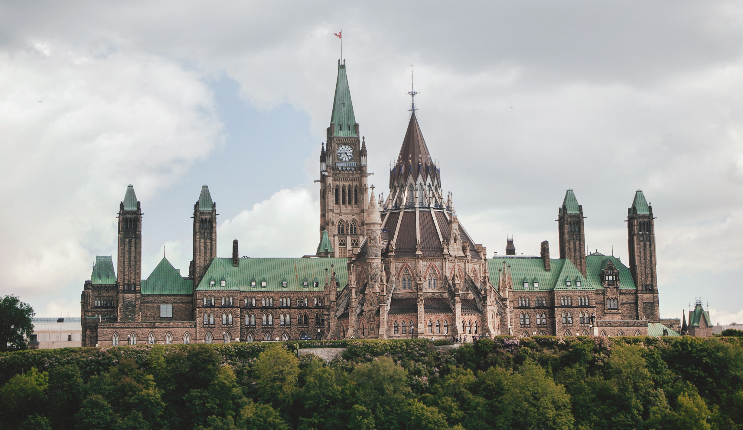
SOCIAL INSTITUTIONS
Photo by Tetyana Kovyrina from Pexels.com

Slide 12

Social Structures & Social Problems
Social Institutions establish guidelines & boundaries in our interactions
Social institutions may cause or reinforce inequalities and injustices.
In particular, they often provide greater advantages to certain individuals or groups.
Social institutions often benefit some more than others and can prevent people from fully participating in a society.
Government policies on daycare, for example, significantly affect single mothers.
Puzzle 3d photo created by kjpargeter - freepik.com
Notes:
Social Institutions (as part of the social structure) allow us to live together by establishing guidelines and boundaries in our interactions with others.
Social institutions may cause or reinforce inequalities and injustices. In particular, they often provide greater advantages to certain individuals or groups. Social institutions often benefit some more than others and can prevent people from fully participating in a society.
Government policies on daycare, for example, significantly affect single mothers.
[possible activity/case study]

Slide 13
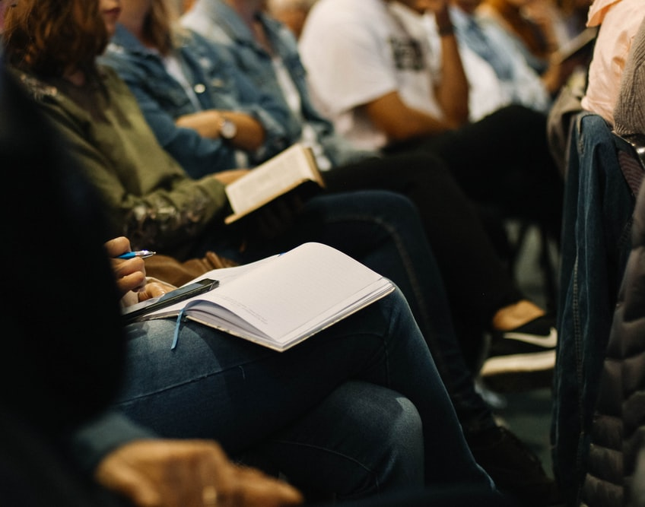
Social Analysis
Social Analysis means critically thinking about how we perceive and understand social problems.
In the next section, we will consider a few methods of social analysis.
We will also explore key terms, like ideology and discourse, that will help us to explore in greater depth the dynamics of social problems.
Photo by Sincerely Media on Unsplash
Notes:
Social Analysis means critically thinking about how we perceive and understand social problems.
In the next section, we will consider a few methods of social analysis.
We will also explore key terms, like ideology and discourse, that will help us to explore in greater depth the dynamics of social problems.

Slide 14

SHAPING Social Institutions
One way to think of social institutions is as the product of historic problem-solving.
As societies grew and developed, more formal organized systems were needed for efficiency, safety, and productivity.
Take policing, for example. Most of us cannot imagine a society without policing, but the institution of modern is actually less than 200 years old and was shaped by the needs of the power structure of society at the time.
Artwork by Kenneth Reaume is licensed under a CC BY-NC-SA 4.0 International License.
Notes:
One way to think of social institutions is as the product of historic problem-solving.
As societies grew and developed, more formal organized systems were needed for efficiency, safety, and productivity.
Take policing, for example. Most of us cannot imagine a society without policing, but the institution of modern is actually less than 200 years old and was shaped by the needs of the power structure of society at the time.

Slide 15
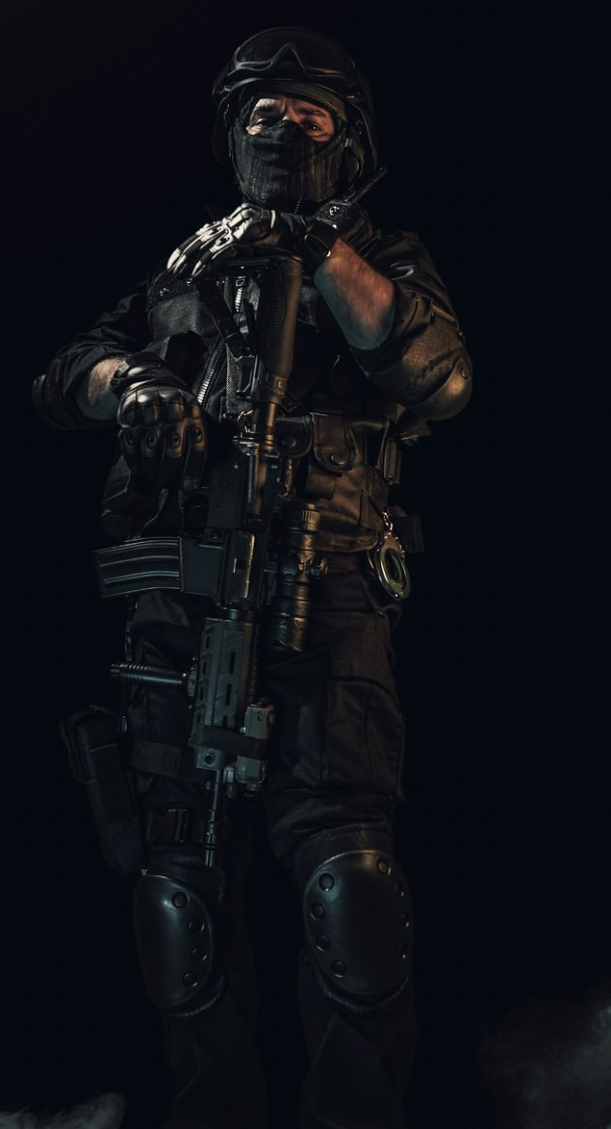
SHAPING Social Institutions
Modern policing is actually less than 200 years old and is a new institution.
Prior to the 19th century there were soldiers and people employed in a capacity similar to today’s private security guards.
Rulers commanded the army, but had to be very careful about using them too often against their own people for fear that the population would revolt and/or the soldiers would turn against their boss.
Wealthy nobles and landowners would employ their own private guards (often former soldiers) to protect their property and households.
They received as much protection as they could afford.
Most everyone else had to rely on the collective sentiment and energy of the communities in which they lived to deliver justice in the event of a dispute.
Photo by HIZIR KAYA on Unsplash
Notes:
Modern policing is actually less than 200 years old and is a new institution.
Prior to the 19th century there were soldiers and people employed in a capacity similar to today’s private security guards.
Rulers commanded the army, but had to be very careful about using them too often against their own people for fear that the population would revolt and/or the soldiers would turn against their boss.
Wealthy nobles and landowners would employ their own private guards (often former soldiers) to protect their property and households.
They received as much protection as they could afford.
Most everyone else had to rely on the collective sentiment and energy of the communities in which they lived to deliver justice in the event of a dispute.

Slide 16

Principles of Law Enforcement 1829
SIR ROBERT PEEL
Police use physical force to the extent necessary to secure observance of the law or to restore order only when the exercise of persuasion, advice and warning is found to be insufficient.
Police, at all times, should maintain a relationship with the public that gives reality to the historic tradition that the police are the public and the public are the police; the police being only members of the public who are paid to give full-time attention to duties which are incumbent on every citizen in the interests of community welfare and existence.
Police should always direct their action strictly towards their functions and never appear to usurp the powers of the judiciary.
The test of police efficiency is the absence of crime and disorder, not the visible evidence of police action in dealing with it.
The basic mission for which the police exist is to prevent crime and disorder.
The ability of the police to perform their duties is dependent upon public approval of police actions.
Police must secure the willing cooperation of the public in voluntary observance of the law to be able to secure and maintain the respect of the public.
The degree of cooperation of the public that can be secured diminishes proportionately to the necessity of the use of physical force.
Police seek and preserve public favor not by catering to the public opinion but by constantly demonstrating absolute impartial service to the law.
Photo by Todd Kent on Unsplash
Notes:
Robert Peel was a conservative politician who was a founder of the modern Conservative Party. He went on to become British Prime Minister. He is known as the father of modern policing, having established the Metropolitan Police Force for London and a first set of Instructions to Officers which became Peel's Principles of Law Enforcement 1829
They are …
The basic mission for which the police exist is to prevent crime and disorder.
The ability of the police to perform their duties is dependent upon public approval of police actions.
Police must secure the willing cooperation of the public in voluntary observance of the law to be able to secure and maintain the respect of the public.
The degree of cooperation of the public that can be secured diminishes proportionately to the necessity of the use of physical force.
Police seek and preserve public favor not by catering to the public opinion but by constantly demonstrating absolute impartial service to the law.
Police use physical force to the extent necessary to secure observance of the law or to restore order only when the exercise of persuasion, advice and warning is found to be insufficient.
Police, at all times, should maintain a relationship with the public that gives reality to the historic tradition that the police are the public and the public are the police; the police being only members of the public who are paid to give full-time attention to duties which are incumbent on every citizen in the interests of community welfare and existence.
Police should always direct their action strictly towards their functions and never appear to usurp the powers of the judiciary.
The test of police efficiency is the absence of crime and disorder, not the visible evidence of police action in dealing with it.

Slide 17
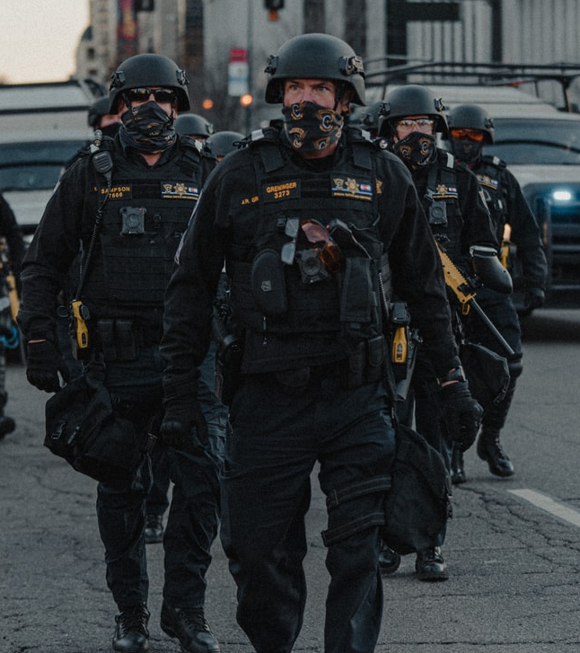
SHAPING SOCIETY
Considering Peel’s Principles
How well the work of modern police forces match these principles?
Should things be changed?
Can they be changed?
Whose interests do the rules and organization of institutions, as they currently exist, serve?
What would happen if the rules and organization of the institution were to change?
Or if it were to disappear completely?
Photo by LOGAN WEAVER | @LGNWVR on Unsplash
Notes:
Considering Peel’s Principles
How well the work of modern police forces match these principles
Should things be changed?
Can they be changed?
Whose interests do the rules and organization of institutions, as they currently exist, serve?
What would happen if the rules and organization of the institution were to change?
Or if it were to disappear completely?

Slide 18
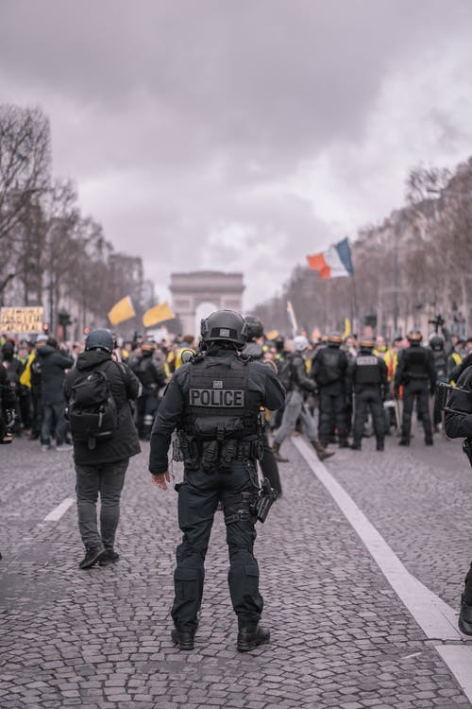
CASE STUDY
Photo by Alotrobo from Pexels

Slide 19
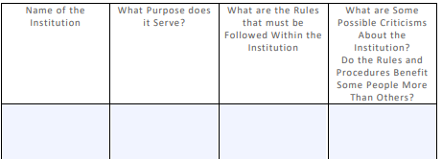
CASE STUDY
Consider Peel’s Principles
How well the work of modern police forces match these principles?
Should things be changed?
Can they be changed?
lf whose interests do the rules and organization of institutions, as they currently exist, serve?
What would happen if the rules and organization of the institution were to change?
What would happen if they were to disappear completely?
Photo by Alotrobo from Pexels
Notes:
BREAK OUT GROUP or LARGE CLASS DISCUSSION
Considering Peel’s Principles
How well the work of modern police forces match these principles
Should things be changed?
Can they be changed?
lf whose interests do the rules and organization of institutions, as they currently exist, serve
What would happen if the rules and organization of the institution were to change
Or if it were to disappear completely?

Slide 20

BREAK
Photo by Hannah Tims on Unsplash
Notes:
15 Minute Break
This slide can be moved to where you have your class break(s)

Slide 21


ATTENDANCE
ATTENDANCE MATTERS
Image by pch.vector - freepik.com
Notes:
This attendance slide can be moved to wherever in your class that you take attendance.
Usually attendance is taken around class breaks, or at the beginning or at the end of class.

Slide 22
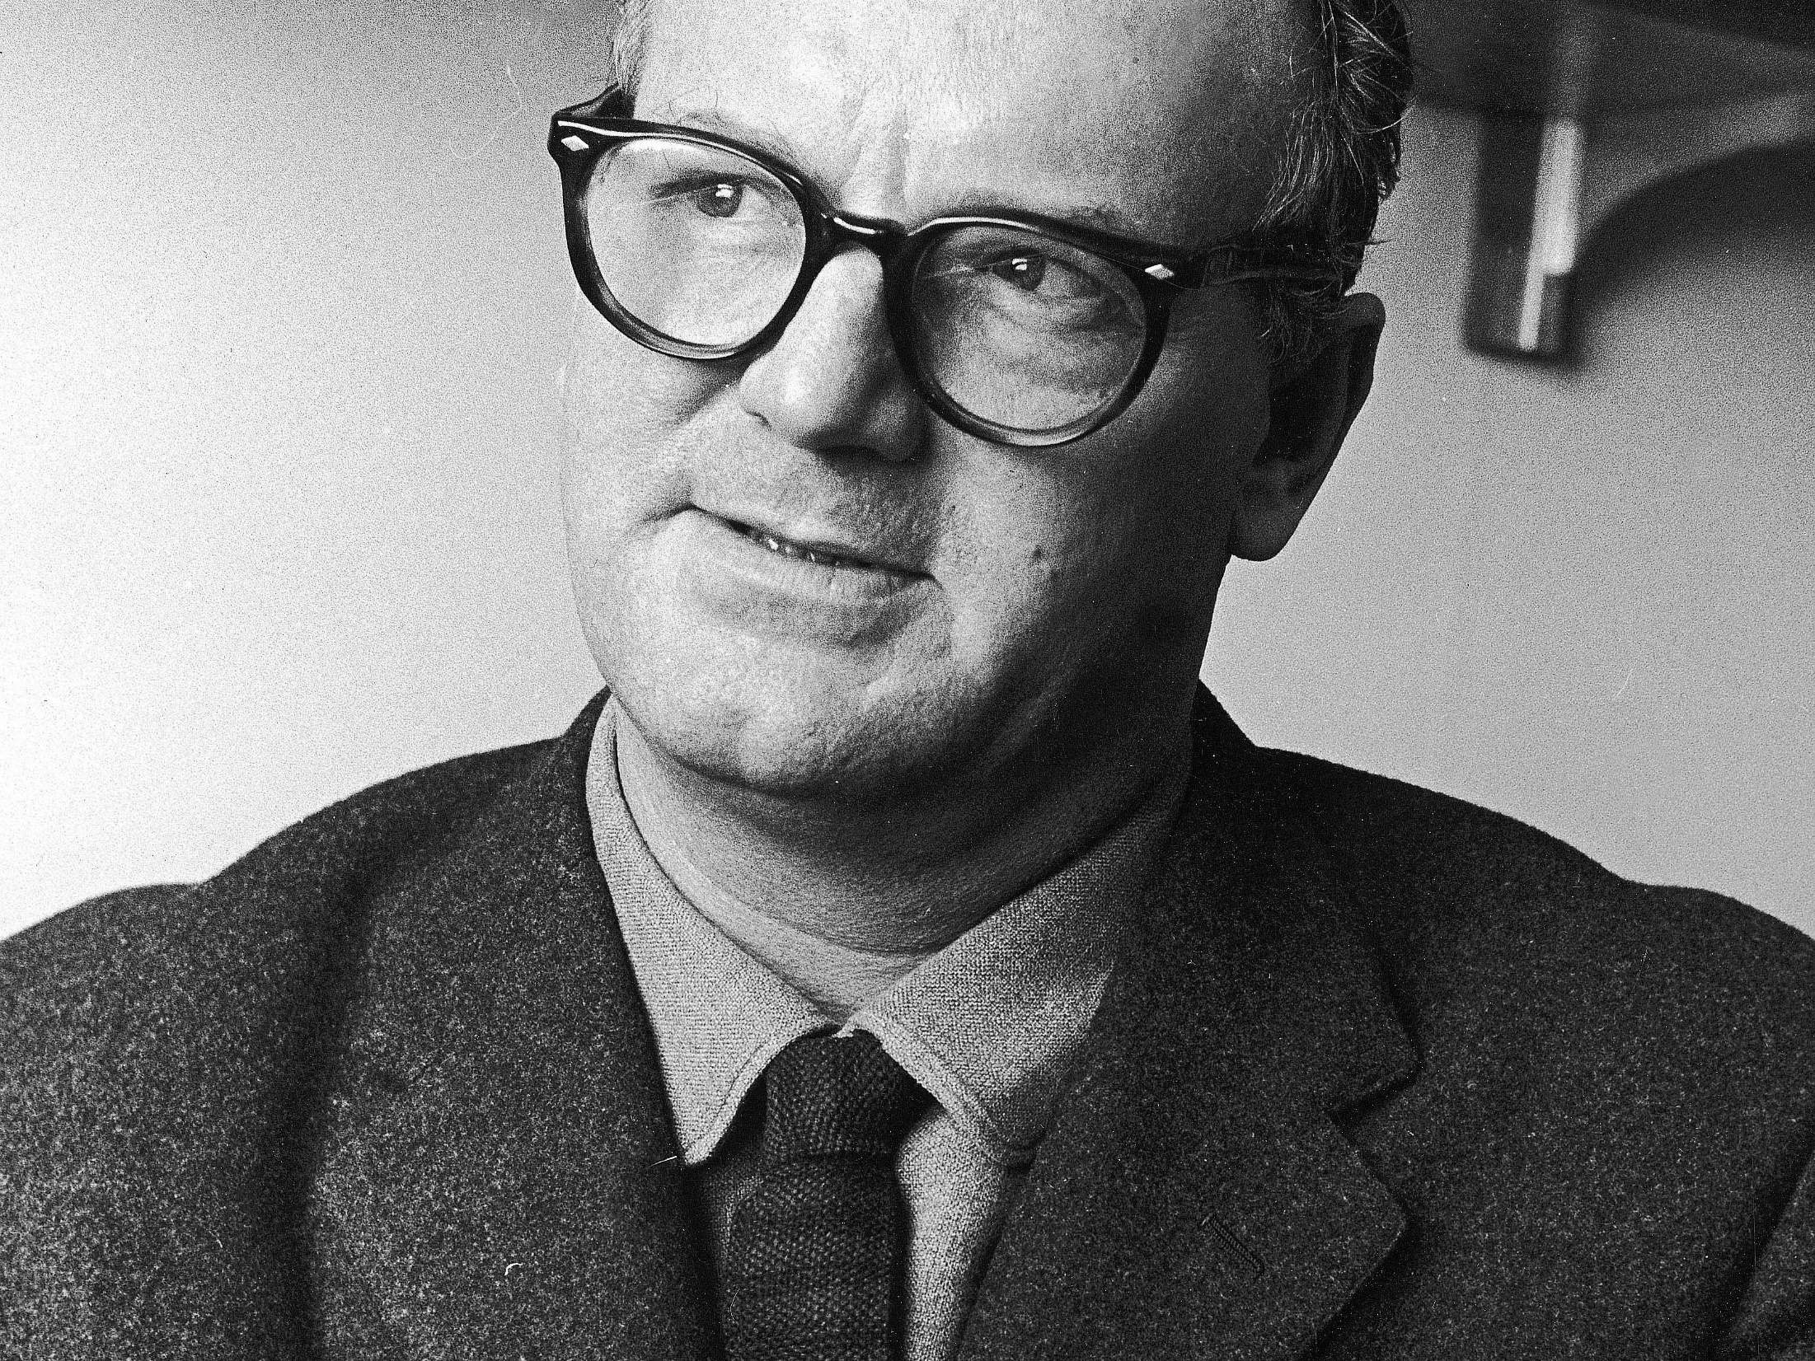
Individual Problems
vs
Social Problems
In The Sociological Imagination (1959), Sociologist C. Wright Mills drew a distinction between personal troubles and public issues.
According to Mills, a personal trouble was when the “values cherished by an individual are felt by him to be threatened.”
A public issue, on the other hand, is when “some value cherished by publics is felt to be threatened.”
Photo of Charles Wright Mills Source: Archive Photos / Getty Images
Notes:
In The Sociological Imagination (1959), Sociologist C. Wright Mills drew a distinction between personal troubles and public issues.
According to Mills, a personal trouble was when the “values cherished by an individual are felt by him to be threatened.”
A public issue, on the other hand, is when “some value cherished by publics is felt to be threatened.”
A social problem is a public issue. It is an issue or condition that people feel is wrong and widespread.
It is also an issue that people feel can be changed and should be changed.

Slide 23
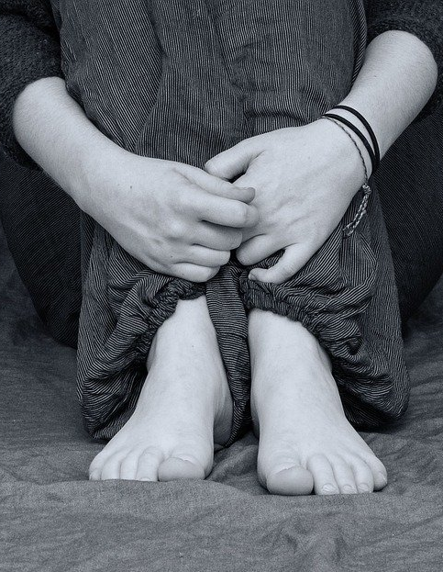
Individual Problems
Values cherished by an individual are felt by him to be threatened
Matters of personal misfortune
Image by Anemone123 from Pixabay
Notes:
Individual problems can be thought of as matters of personal misfortune. They are caused by and affect just the person involved and perhaps a small circle of people close to them

Slide 24

Social Problems
A public issue. It is an issue or condition that people feel is wrong and widespread.
It is also an issue that people feel can be changed and should be changed.
Image by Peggy und Marco Lachmann-Anke from Pixabay
Notes:
A social problem is a condition, pattern of behaviour, or issue that affects a particular society and that people believe warrants public concern and collective action to change.
A social problem exists when there is a sizable difference between the ideals of a society and its reality.
An issue only becomes a social problem when people have been able to convince others that it requires public attention and collective action.
Power and exposure influence the extent to which people can be convinced a given issue is a social problem.
Social problems are determined not just by the number of people they affect but by how they affect them.
Defining a social problem involves convincing the public that both the causes and solutions for a problem lie beyond individual responsibility.

Slide 25
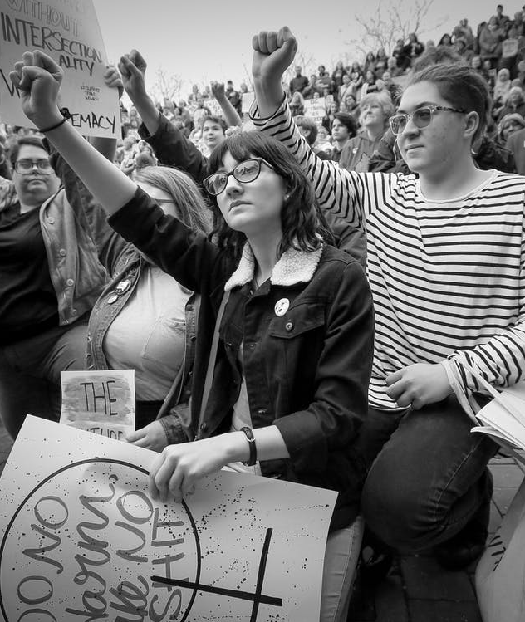
What makes IT a Social Problem?
A social condition or a pattern of behaviour that requires public concern and collective action to bring about change.
When people agree that there is a sizable difference between the way things are and the way they should be!
An issue that society agrees is harmful and should be changed.
Photo by Andrew McMurtrie – Pexels.com
Notes:
A social problem is a social condition or a pattern of behaviour that people believe requires public concern and collective action to bring about change.
Social problems exist when people agree that there is a sizable difference between the way things are and the way they should be.
To put it simply, a social problem is an issue that society agrees is harmful and should be changed.

Slide 26
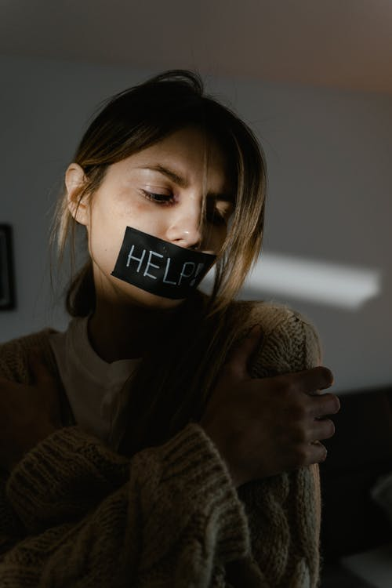
A Problem for whom?
The values of a society distinguish social problems from individual problems.
In any society different people will hold different values and beliefs.
What some people think of as an individual problem others would see as a social problem.
We won’t all believe that the same issues should be considered social problems.
Photo by Mart Production - Pexels.com
Notes:
The values of a society distinguish social problems from individual problems.
But…
In any society different people will hold different values and beliefs.
What some people think of as an individual problem others would see as a social problem.
We won’t all believe that the same issues should be considered social problems.

Slide 27

Social Problems
CLAIMS-MAKERS
People need to be convinced!
People act to convince the broader public that it requires public attention & collective action.
Claims-makers are the individuals, groups and/or organizations that seek to inform the public about the issue.
There are countless claims-makers bringing attention to issues.
People with power and exposure, such as politicians and celebrities, are often more successful at bringing issues to public attention.
But any one of us can become a claims-maker!
Photo by Polina Tankilevitch – Pexels.com
Notes:
People need to be convinced!
A social problem only becomes a social problem when the people who care about it have been able to convince the broader public that it requires public attention and collective action.
Claims-makers are the individuals, groups and/or organizations that seek to inform the public about the extent and nature of a particular problem.
There are countless claims-makers trying to bring attention to issues.
People with power and exposure, such as politicians and celebrities, are often more successful at bringing issues to public attention.
But any one of us can become a claims-maker and work with others to raise concerns about the issues we care about.

Slide 28
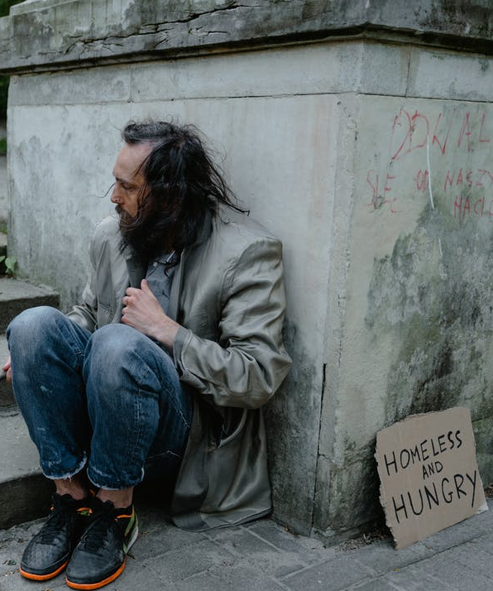
Social Problems
Crucially, establishing an issue or condition as a Social Problem is about demonstrating that both the causes and solutions for the problem lie outside of the individual.
When the causes and solutions like outside the individual, we can say they are located in the Social Structure.
Photo by MART PRODUCTION - Pexels.com
Notes:
Crucially, establishing an issue or condition as a Social Problem is about demonstrating that both the causes and solutions for the problem lie outside of the individual.
When the causes and solutions like outside the individual, we can say they are located in the Social Structure.

Slide 29

Social Problems
SOCIOLOGICAL IMAGINATION
A way to link the things that trouble us individually with bigger problems in society’s social structure.
Reflect and analyze society’s social structure and how changes can affect our personal experiences
Taking a step back from the way we normally try to understand the world—Instead, we try to see and understand how society is organized to recognize the social problems or issues that affect people’s everyday lives
Artwork by Kenneth Reaume is licensed under a CC BY-NC-SA 4.0 International License.
Notes:
A way to link the things that trouble us individually with bigger problems in society’s social structure.
Reflect and analyze society’s social structure and how changes can affect our personal experiences
Taking a step back take a step back from the way we normally try to understand the world—through our personal knowledge and experiences. Instead, we try to see and understand how society is organized to recognize the social problems or issues that affect people’s everyday lives.
It’s important to remember that just because we believe something to be true doesn’t make it so
When we use the sociological imagination, we collect data, do research, and analyze our findings. Most importantly, we use our critical thinking skills.
We try to see beyond our own standpoint—and the prejudices and assumptions we might hold—to formulate what social problems are, why they exist, and how we may act to create positive, lasting solutions that help as many people as possible.

Slide 30
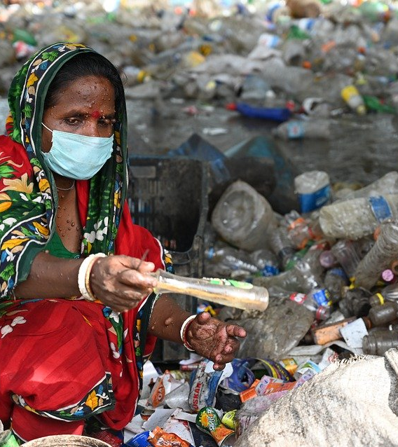
SOCIAL PROBLEMS
IN CONTEXT
POINT OF VIEW!
How do social problems show up in our everyday lives?
As feminist and anti-racist historians have pointed out, our understanding of history is told from the perspective of powerful white men.
We know a great deal about Christopher Columbus but very little about the people whose land he took over and were massacred.
Image by Mumtahina Rahman from Pixabay
Notes:
POINT OF VIEW!
How do social problems show up in our everyday lives?
As feminist and anti-racist historians have pointed out, our understanding of history is told from the perspective of powerful white men.
We know a great deal about Christopher Columbus but very little about the people whose land he took over and were massacred.

Slide 31
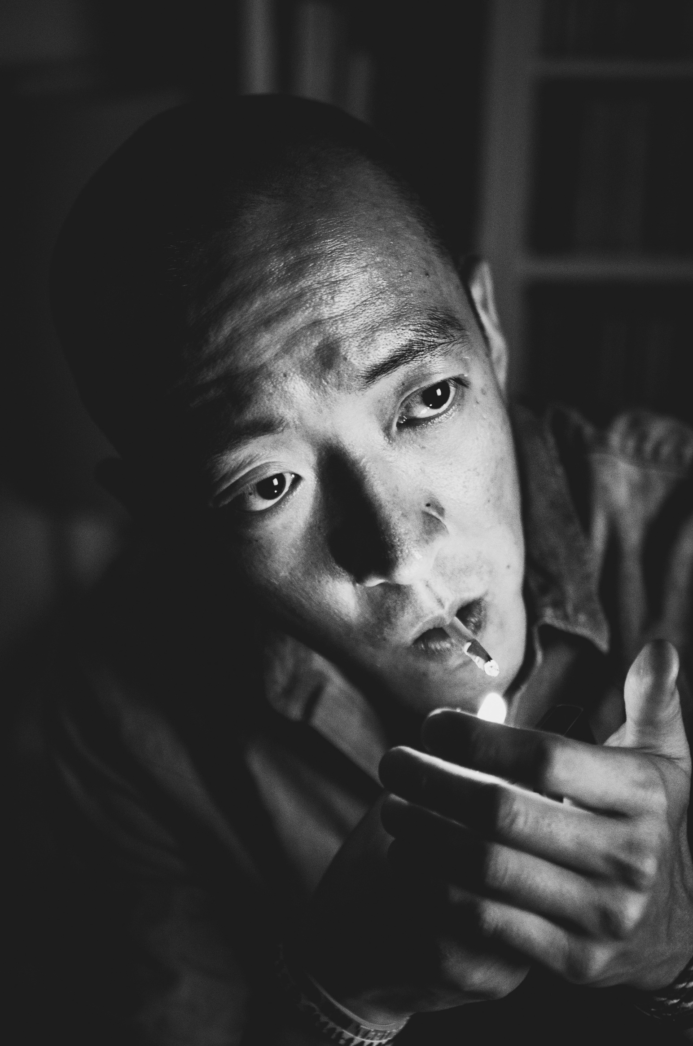
Social Problems
IN CONTEXT
Elementary students continue to learn about the heroic acts of European settlers but little about the experiences of First Nations who already lived on this land
This reminds us that knowledge is not neutral.
What we know and what we are able to know are shaped by our sources of information.
This in turn affects what we know about social problems and how we act in relation to them.
Our understanding of social problems is always shaped by history, politics, and culture.
Image by BlossomFilm from Pixabay
Notes:
Elementary students continue to learn about the heroic acts of European settlers but little about the experiences of First Nations who already lived on this land
This reminds us that knowledge is not neutral.
What we know and what we are able to know are shaped by our sources of information.
This in turn affects what we know about social problems and how we act in relation to them.
Our understanding of social problems is always shaped by history, politics, and culture.

Slide 32

BREAK
Photo by Pixabay from Pexels
Notes:
15 Minute Break
This slide can be moved to where you have your class break(s)

Slide 33


“POST TRUTH”
Notes:
After watching the video,
https://youtu.be/Ck0yqUoBY7M
Answer the following questions:
What is “truthiness” and “post-truth”?
How do you think truthiness and “post-truth” are related to stereotypes and prejudice?
Why is thinking about a social problem in terms of “a gut feeling you have” dangerous?
The discussion about truthiness and post-truth is very relevant to the discussion on “fake news”
TRUTHINESS
“The belief in what you feel to be true rather than what the facts will support”

Slide 34
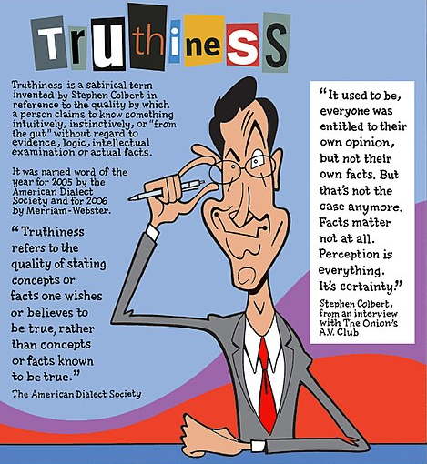
TRUTHINESS
DEFINITION
“The belief in what you feel to be true rather than what the facts will support”
The discussion about truthiness and post-truth is very relevant to the discussion on “fake news”
Truthiness Cartoon By Greg Williams CCBY-SA 2.5 Wikiworld
Notes:
After watching the video, answer the following questions:
What is truthiness and “post-truth”?
How do you think truthiness and “post-truth” are related to stereotypes and prejudice?
Why is thinking about a social problem in terms of “a gut feeling you have” dangerous?
The discussion about truthiness and post-truth is very relevant to the discussion on “fake news”
TRUTHINESS
“The belief in what you feel to be true rather than what the facts will support”

Slide 35
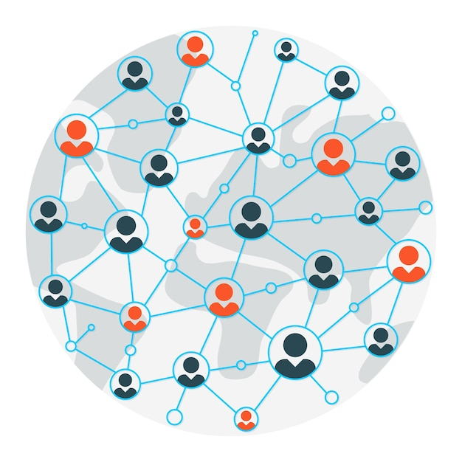
Social Structure
Social structure refers to the way society is organized.
The basic elements of a social structure are statuses, roles, groups and institutions.
In subsequent chapters, we will discuss statuses, roles and groups.
But here we will focus on the importance of social institutions and the way the are linked to social problems.
Image by macrovector - freepik.com
Notes:
Social structure refers to the way society is organized.
The basic elements of a social structure are statuses, roles, groups and institutions.
In subsequent chapters, we will discuss statuses, roles and groups.
But here we will focus on the importance of social institutions and the way the are linked to social problems.

Slide 36

Social Institutions
The most recognized social institutions are:
Family
Religion
Government
Economy
Education
Culture
Media
Policing
Photo by Daniele Colucci on Unsplash
Notes:
The most recognized social institutions are:
The Family
Religion
Government
Economy
Education
Culture
Media
These social institutions guide and shape our attitudes, values, and even our behaviour.
For example, religion teaches us a set of values and beliefs.
The media (i.e., the news) not only informs but interprets events for us.
The education system shapes our thinking.
The economy determines our work and spending habits, while the government puts into place policies that affect our daily lives.
Education is designed to teach young people specific subjects and skills that may be useful in their lives.
Law is an organized way to settle disputes between people, to punish those who have hurt others, and to protect communities from those who damage them by taking unfair advantages for themselves.
Religion is meant to provide us a moral and ethical framework within which to live our lives and relate to others.
Mass media is meant to provide entertainment and information to people who are separated over large distances.
All of these are institutions because they exist to serve a specific social purpose.
They arrange the way we live together.
Given this, is it not interesting to consider how some of these institutions first developed and why they are set up the way they are?

Slide 37
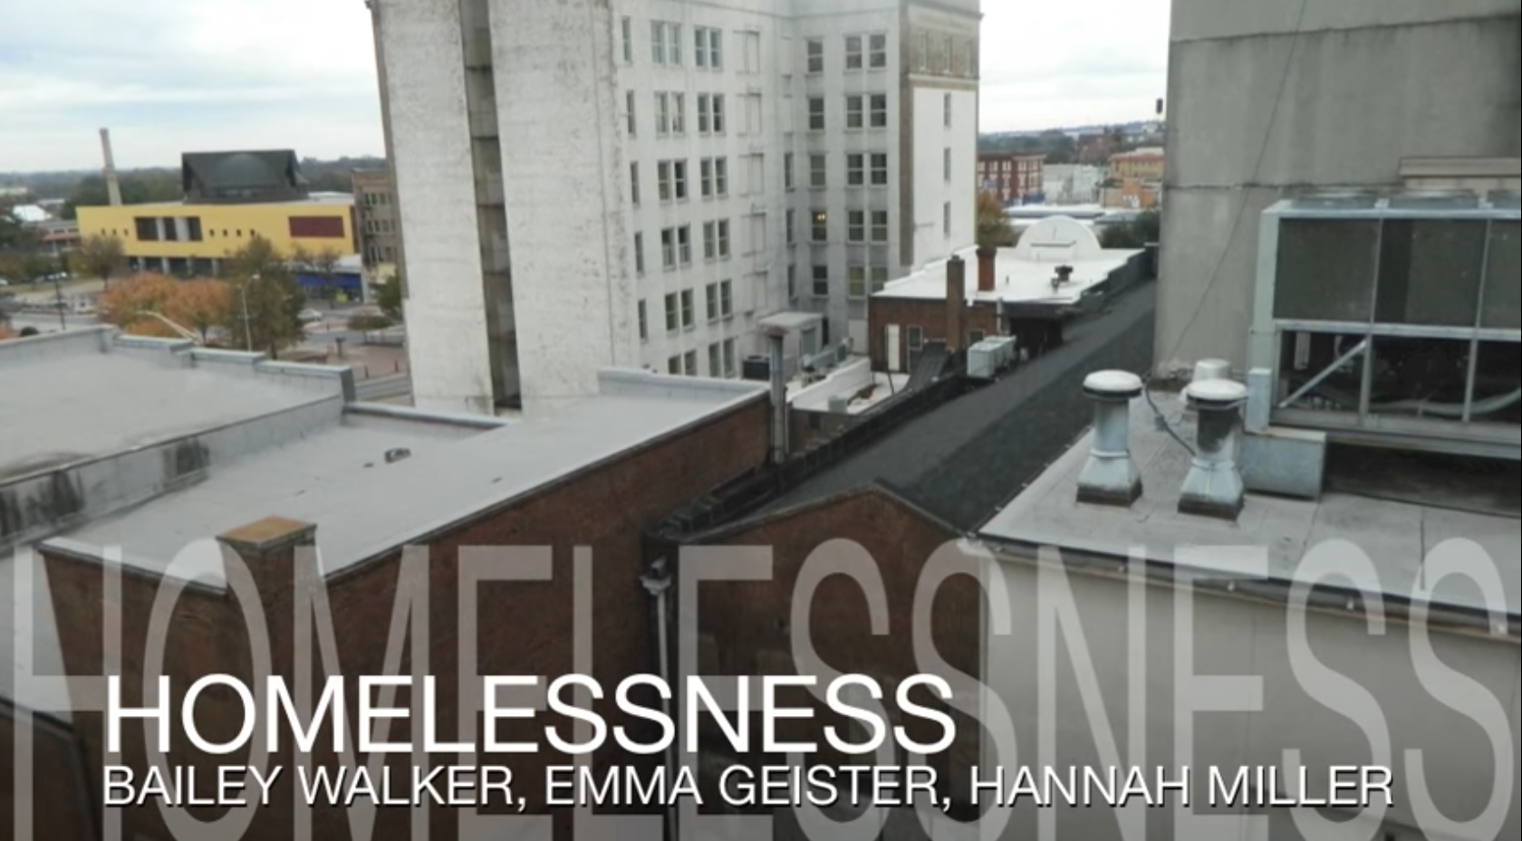
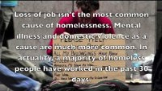
HOMELESSNESS – SOCIAL ACTION
Notes:
SOCIAL ACTION
Looking at what we can personally do with Homelessness
https://youtu.be/RjO8hBNSvVI

Slide 38

BREAK
Photo by Kevin Menajang Pexels.com
Notes:
15 Minute Break
This slide can be moved to where you have your class break(s)

Slide 39

GROUP WORK
Diverse Group Photo by freepik.com
Notes:
In your groups…
Name some social problems that you are concerned about ?
Why are you concerned about it, Individually and or as a group?
What part does society have to play in this problem?
What are some possible solutions to the social problem?

Slide 40
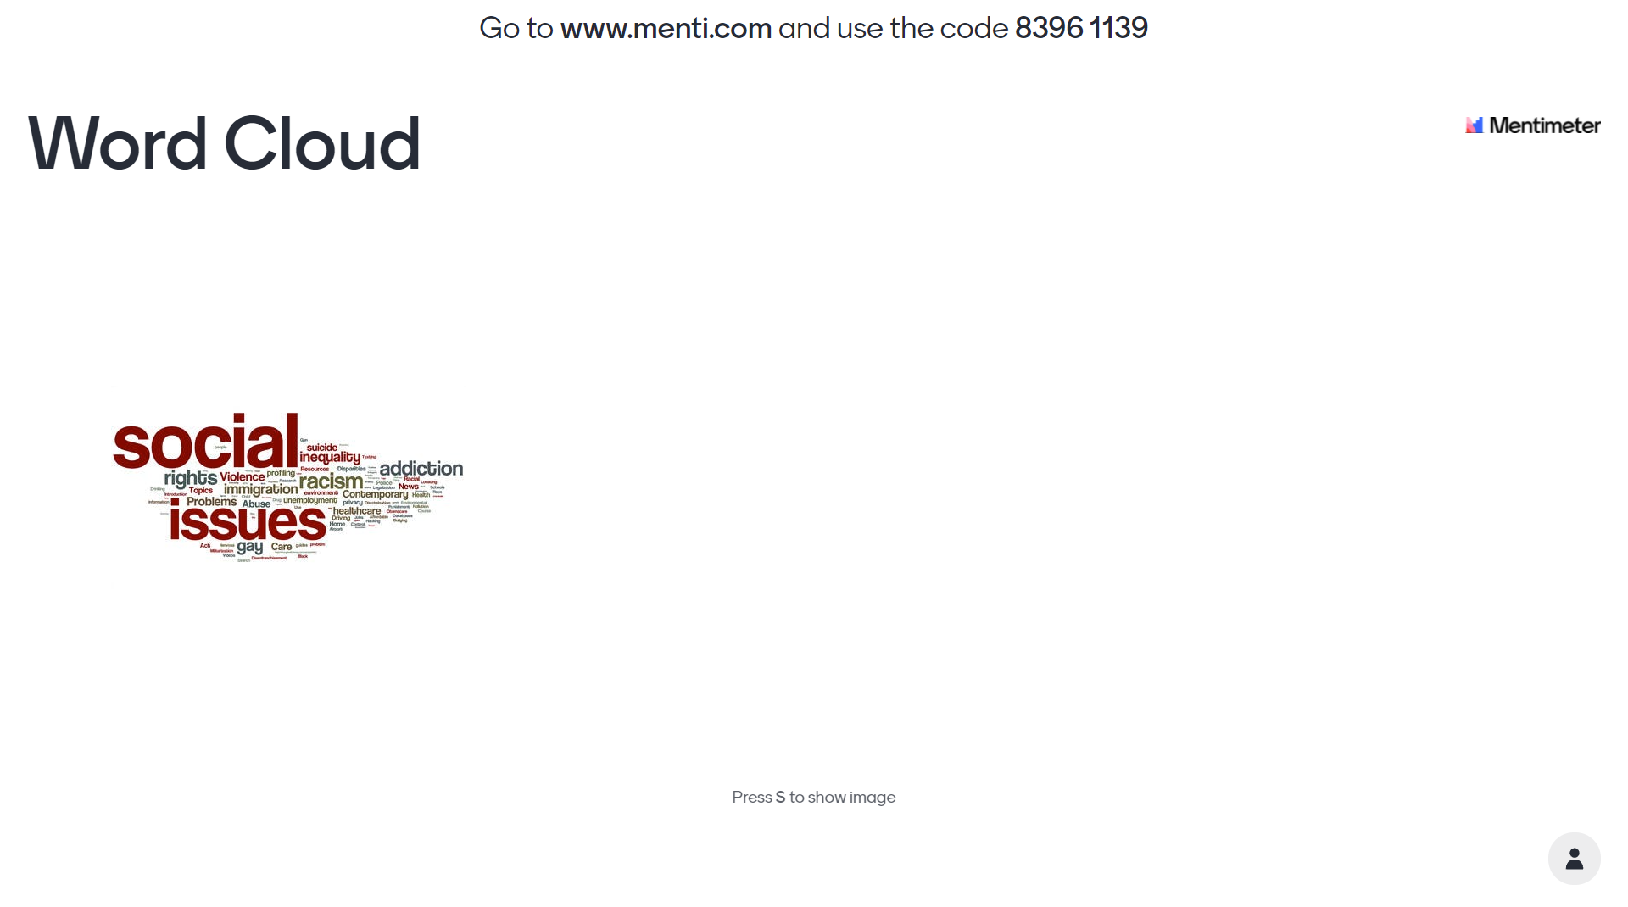
WORD CLOUD
Individually post on the Mentimeter Word Cloud some Social Issues/Problems that concern you!
Pick up to 5
Notes:
You have to setup a new Mentimeter Poll.
https://www.menti.com/o7w5xsgina
MentiMeter Code : 8396 1139

Slide 41
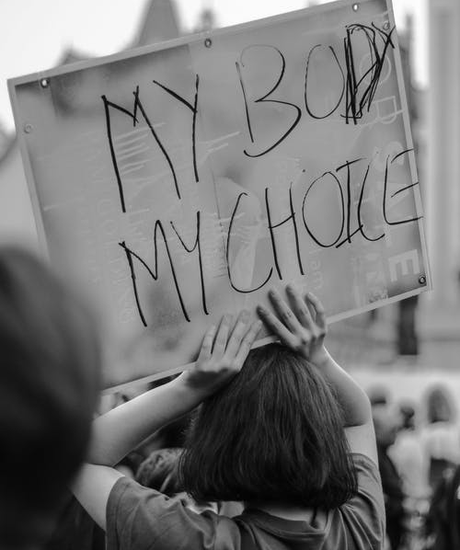
GROUPWORK
SOCIAL PROBLEMS
In your groups…
Name some social problems that you are concerned about ?
Why are you concerned about it, Individually and or as a group?
What part does society have to play in this problem?
What are some possible solutions to the social problem?
Photo by Duané Viljoen – Pexels.com
Notes:
In your groups…
Individually post on the Mentimeter Word Cloud some Social Issues/Problems that concern you!
Name some social problems that you are concerned about ?
Why are you concerned about it, Individually and or as a group?
What part does society have to play in this problem?
What are some possible solutions to the social problem?

Slide 42
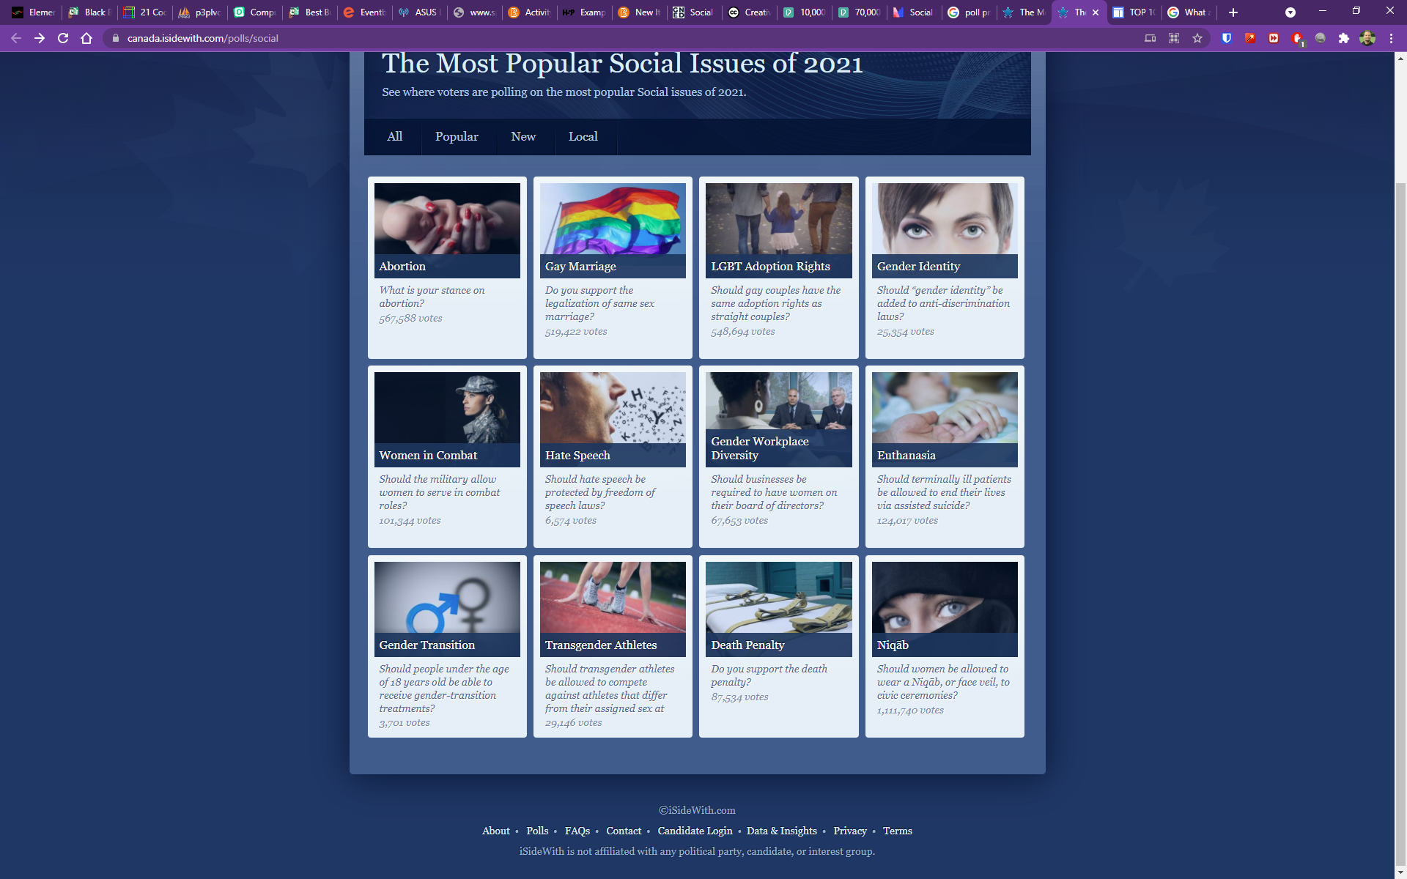
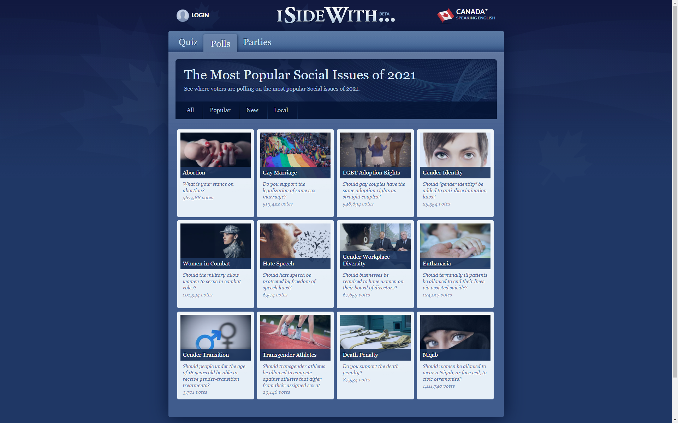
https://canada.isidewith.com/polls/social
Notes:
The Most Popular Social Issues in Canada?
https://canada.isidewith.com/polls/social

Slide 43

QUESTIONS
Photo by Pixabay from Pexels
Notes:
QUESTIONS

